Slide 1
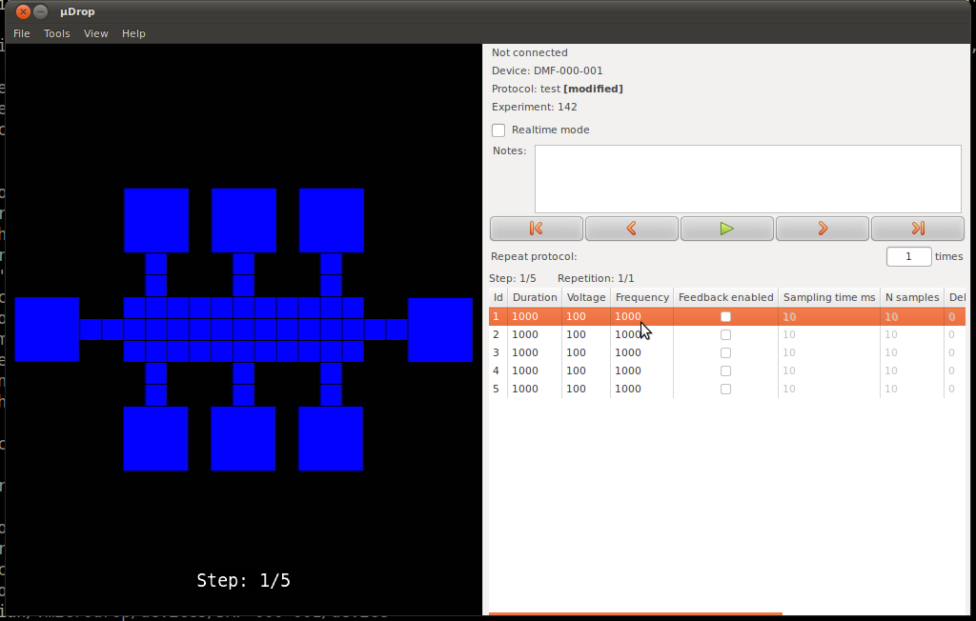
Microdrop: plugin development
Christian Fobel
July 15, 2014

Slide 2
Overview
Main goals for this tutorial
provide a general idea of what can be accomplished through writing a plugin
demonstrate the basic requirements for developing a plugin
signal-handling
plugin options

Slide 3
Application overview

Slide 4
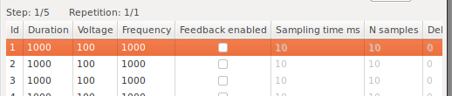
Terminology
Protocol
sequence of "steps"
e.g., sequence of electrode activations to move a drop
Step
execution step of a protocol
each step has a state associated with it

Slide 5
Creating a protocol
Create one or more steps
For each step, set the desired options
values can be modified in the protocol grid view

Slide 6
Protocol playback
Protocols can be played back by pressing "Play" button
Starting at the currently selected step, each step will be cycled through, in order
At each step, the options corresponding to the current step are set

Slide 7
What is a plugin?
Packaged code that extends the functionality of an application
Responds to events that occur in the program
Example:
dmf_control_board plugin:
controls the switching board to activate the selected electrodes for the current protocol step
Potential plugin ideas:
control the position of a motor, magnet, etc. based on the current step
perform image processing on a video frame

Slide 8
Signals
Notification that an event has occurred in the program
For example:
a new step is created
protocol "play" button is pressed
step selection has changed
Most signals fall into four categories
protocol signals
step signals
step options signals
app options signals

Slide 9
Protocol signals
on_protocol_run
emitted when "play" button is pressed
on_protocol_pause
emitted when either
"pause" button is pressed
protocol finishes running
on_protocol_created
a new protocol is created
on_protocol_swapped
an existing protocol is loaded

Slide 10
Step signals
on_step_created
a new step is created
on_step_swapped
another existing step is selected (or transitioned to in playback mode)
on_step_options_changed
the options for a step are modified
e.g.,
a new electrode is activated on the DMF device view
the actuation voltage is changed

Slide 11
Options
Basic data types
boolean, integer, string, file path, directory path, etc.
App options
application-level settings
apply to all protocols
e.g., video overlay opacity
Step options
options to apply on a per-step basis
e.g., state of electrode channels, voltage, frequency, duration, etc.

Slide 12
Plugins
How do we make use of these signals and options?
Write a plugin!
In fact, all core application functionality is handled by plugins
e.g., DMF device view plugin

Slide 13
Handling signals
How do we request to be notified of a particular signal?
Implement appropriate class method
Example:
on_step_swapped() handler of DmfDeviceController plugin
handles any transition from one step to another

Slide 14
App fields
Application-wide settings for a plugin
Add AppFields to our plugin class
AppFields defines a list of fields for which a value should be saved for the plugin
a "field" specifies the type and validating restrictions for a corresponding "option" value
"field" -> type (think int, bool, string, etc.)
"option" -> value (think 0, True, "hello", etc.)

Slide 15
Step fields
Per-protocol-step settings for each plugin
Adding StepFields is similar to AppFields
StepFields defines list of fields for which values should be stored for each step of a protocol
Example
Waveform voltage
Waveform frequency
Feedback enabled

Slide 16
Advanced topics
There are many things not covered today
each AppField/StepField can be configured to not show in the GUI
useful for types that do not have an appropriate GUI widget available
e.g., the state of electrode channels
not in protocol grid with the rest of the step fields
schedule requests can be made to ensure signals are processed in a particular order, when necessary
e.g., during playback, a motor might need to finish moving into position before activating a temperature probe

